Slide 1
Introduction to CS106.3
Algorithms and Data Structures

Slide 2
Context of Computing
Input Data
Processing
Output Results
Computer Program
Instructions + Data
Algorithms
Data Structures

Slide 3
What are algorithms?
An algorithm describes the method of solving a problem.
Algorithm is an organization of set of steps to be carried out to achieve a specific task.
Algorithms are implemented using the 3 fundamental constructs available in any programming language,
Sequencing,
Selection, and
Iteration.
Algorithms are evaluated based on the CPU time and memory they consume (with increased problem size).

Slide 4
Example
Problem - Finding maximum from a set of values
Algorithm
max = data[0]
for(i=1; i<n; i++)
if(data[i]>max) max=data[i];
Both running time and space/memory requirement are proportional to the size of the problem n.
Can we stop the search in case the maximum is in the first element?

Slide 5
What are data structures?
A program need to store/hold, input, intermediate and output data items.
Programming languages support data storage via
Variables of basic data types
Arrays
Records/structures
More complex data structures can be implemented using the basic data types and other language elements available.
Linked lists
Trees

Slide 6
Examples
int age;
float marks[100];
struct person { char name[20];
int age;
char phone[10]; } nimal;
nimal
name
 |  | …
 |  |  | …
age
age
marks
phone
 |  | …

Slide 7
Abstract Data Types (ADT)
Abstract data type is a data structure together with standard access functions to access the data stored.
ADT
Access Procedures or Functions
One does not need to know the data structures inside the ADT box or how access functions are implemented to use the ADT

Slide 8
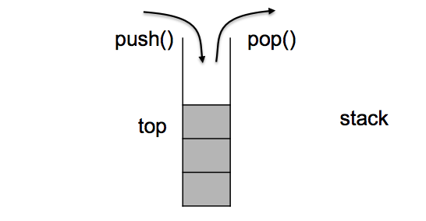
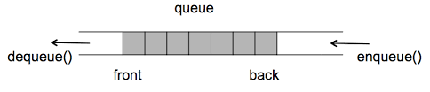
Examples
Stacks and Queues

Slide 9
Topics we cover
Asymptotic Analysis of Algorithms
Searching and Sorting
Recursion
Stacks and Queues
Linked lists
Trees

